Slide 1
Quantum Lecture 4xx
RECAP
Delfi
CHSH inequality

Slide 2
9:15 – 10:00 2 Videos
Lecture 4B2 CHSH second description 10A
https://www.youtube.com/watch?v=sAXxSKifgtU
Lecture 4B2 CHSH second description 10B until (6:40)
https://www.youtube.com/watch?v=8UxYKN1q5sI

Slide 3
10:15 – 11:00 Coderanch
Start with the mybinder.org below
10:15-> Exercise 1 –
https://decpieibmquantumexperience.blogspot.com/2017/10/chsh-experiment-on-quantum-computer.html
10:40 -> Exercise 2 –
https://github.com/Qiskit/ibmqx-user-guides/blob/master/rst/full-user-guide/003-Multiple_Qubits_Gates_and_Entangled_States/002-Entanglement_and_Bell_Tests.rst

Slide 4
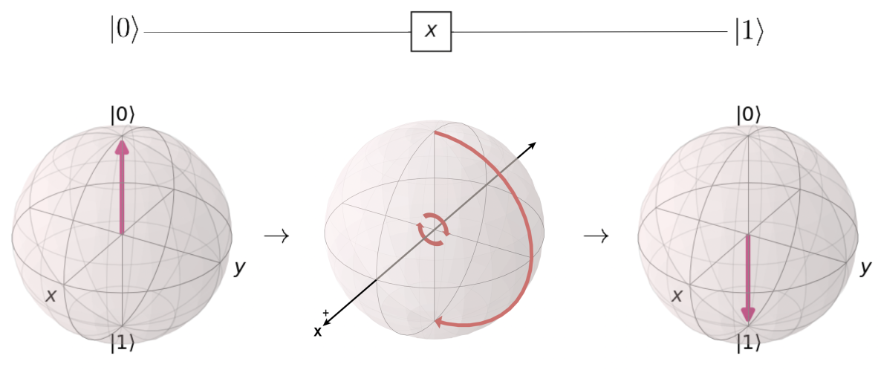
Exercise recaps
What is .measure about
What does the X,Y and Z do as OPERATORS

Slide 5
11:15-11:40
The DTU CHSH game

Slide 6
11:45 – 12:30 Lunch

Slide 7
12:30 -13:30 QFT The very FAST-TRACK !!!
Fourier transform visualized (0-> 10:00)
https://www.youtube.com/watch?v=spUNpyF58BY
Quantum Fourier transform visualized
https://www.youtube.com/watch?v=rRblvBZkz7A

Slide 8
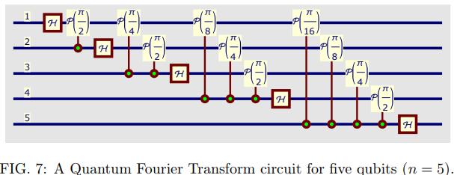
13:30 – 14:00 Coderanch
Try it out - RSA with 5 bit factorization

